Slide 1

Dissection Guide to the Rat
The Norway rat
(Rattus norvegicus)
Family:Muridae

Slide 2
Anatomical Terms
Cranial-toward the head
Caudal-toward the tail
Dorsal-toward the backbone
Ventral-toward the belly side
Lateral-toward the side
Medial-toward the middle
Proximal-closer to the the base of a structure
Distal-farther away from a structure

Slide 3
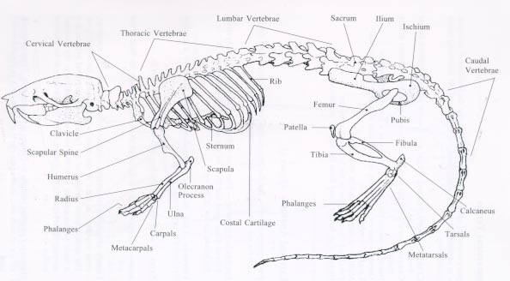
The Skeleton of the Rat

Slide 4
Skinning the Rat
Lay rat on its back
Using a blunt probe, separate the skin from the muscle
Use scissors to cut along ventral midline
Be careful to cut only the skin
Make four lateral incisions
Remove the skin from the body

Slide 5
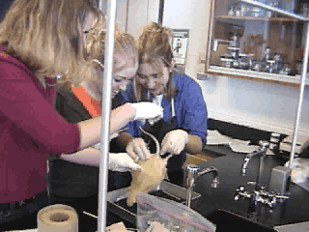
Skinning the Rat

Slide 6
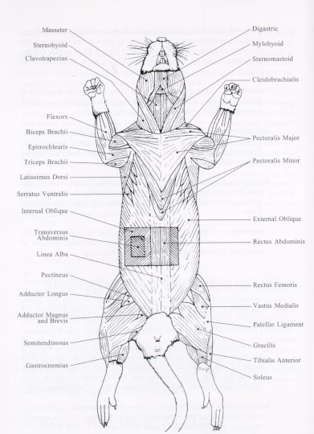
Muscles to Locate
Locate the starred muscles. Draw and label them on your lab report.

Slide 7
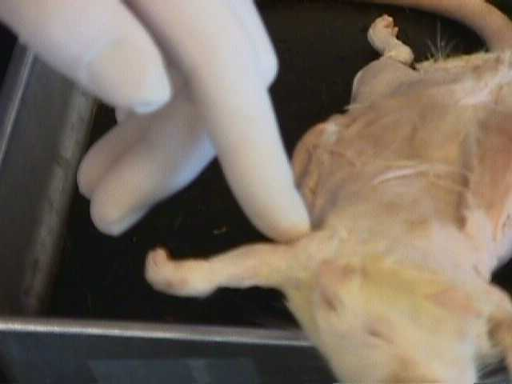
Beginning the Muscle Identification
The Triceps Brachii
Notes:
Dorsal view of the rat

Slide 8
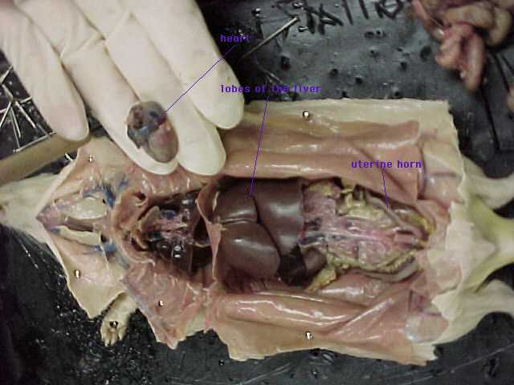
The Internal Anatomy
The first incisions were made down the center of the body cavity and down to the feet and through to the arms. These cuts were made so the skin could be neatly folded back and pinned in place.

Slide 9
After the pinning is complete the interior muscle tissues are exposed, then by making careful incisions, the interior organs can be exposed. Carefully cut into the throat being sure not to cut though the masseter, digastric or the mylohyoid. When the body cavity is laid open the first organs that are seen are the large brown livers, cecum (most commonly mistaken for the stomach), and the small and large intestines. After removing the intestinal group the stomach, pancreas, and spleen become much more visible.
_x0003_ Moving to the respiratory system that lies under the rib cage, carefully but firmly cut up the center of the ribcage. This is will break the breast bone and the ribs when they are pinned back. Opening the rib cage will expose the heart and lungs

Slide 10
Lab Report
Write your lab report using proper reporting form
Include drawings of the muscles, and internal anatomy
Copy and include a drawing of the skeletal system
Write out your conclusion questions

